Slide 1
Enterprise Data Science Bootcamp Human Resources Analysis Predict Attrition November 2019
Bruno Candeias | David Oliveira | Henrique Pereira | Manuel Oom
M20180313 | M20181430 | M20181395 | M20181431

Slide 2





Agenda
The agenda for today will have the following 5 topics:
Why?
Planning & Methodology
Dataset Exploration & Insights
Model Discussion
Next Steps
Why did we choose the Human Resources Analysis Project?
What is our Schedule?
What is our approach?
How did we explored our dataset?
How is our dataset?
What have we discovered so far?
Which are the best scores?
Preliminary results
What are we going to do next?

Slide 3

Why “HR Analysis - Predict Attrition”?
It allows the usage of what has been learned, develop different algorithms to achieve a broader view of the problem and to do a descriptive, predictive and prescriptive analysis of a well known concern for companies.
Descriptive
Analytics
Predictive
Analytics
Prescriptive Analytics
Logistic Regression Classifier
Linear Support Vector Classification
C-Support Vector Classification
Human Resources turnover is very present in our professional life and we would like to know:
Who is going to leave the company? (Predictive Analytics)
What measures can we develop to avoid attrition? (Prescriptive Analytics)
XDBoost
Random Forest Classifier
Classification Neural Network

Slide 4
Methodology
The methodology was divided in 7 steps: Collection, Visualization, Cleansing, Engineering, Development, Selection and Results.
Data Source
Data Exploration
Model Evaluation & Selection
Results
Collection
Visualization
Cleansing
Engineering
Development
Selection
Results
Data Collection
Visualization
Data treatment
Feature Engineering
Model development and optimization
Model
Selection
Results Analysis & Conclusions
The dataset was provided by BI4All to develop a case study. There was no need for data search or data gathering
The dataset was firstly analyzed in Power BI to achieve insights and to better understand the dataset
The dataset was quite clean. Some columns were renamed and others were drop. Additionally, normalization was performed with Min-Max Scaler
Categorical variables were transformed into dummy ones and some variables were created to gather non-explanatory variables
Each model was developed and optimize to define the best hyperparameters to achieve the best results
After achieving the best results of each model, a analysis will be performed to select the best model to answer the questions
Once the analysis of the results is completed, a presentation for the stakeholders will be prepared with conclusions and next steps.

Slide 5

Methodology
The methodology was divided in 7 steps: Collection, Visualization, Cleansing, Engineering, Development, Selection and Results.
Data Source
Data Exploration
Model Evaluation & Selection
Results
Collection
Visualization
Cleansing
Engineering
Development
Selection
Results
Data Collection
The dataset that will be used in the use case contains 1470 records with 35 columns:
The dataset was provided by BI4All to develop a case study. There was no need for data search or data gathering
• Age
• Attrition
• BusinessTravel
• DailyRate
• Department
• DistanceFromHome
• Education
• EducationField
• EmployeeCount
• EmployeeNumber
• EnvironmentSatisfaction
• Gender
• HourlyRate
• JobInvolvement
• JobLevel
• JobRole
• JobSatisfaction
• MaritalStatus
• MonthlyIncome
• MonthlyRate
• NumCompaniesWorked
• Over18
• OverTime
• PercentSalaryHike
• PerformanceRating
• RelationshipSatisfaction
• StandardHours
• StockOptionLevel
• TotalWorkingYears
• TrainingTimesLastYear
• WorkLifeBalance
• YearsAtCompany
• YearsInCurrentRole
• YearsSinceLastPromotion
• YearsWithCurrManager

Slide 6
Methodology
The methodology was divided in 7 steps: Collection, Visualization, Cleansing, Engineering, Development, Selection and Results.
Data Source
Data Exploration
Model Evaluation & Selection
Results
Collection
Visualization
Cleansing
Engineering
Development
Selection
Results
Data Collection
The dataset was provided by BI4All to develop a case study. There was no need for data search or data gathering
Assumptions & Limitations
The dataset is lacking some variables that would be very important:
The motives for leaving the company;
The conditions that others companies are offering;
Hierarchy superior of the employee;
Time stamps (date of hiring and date of quitting);
Historical Data;

Slide 7
Methodology
The methodology was divided in 7 steps: Collection, Visualization, Cleansing, Engineering, Development, Selection and Results.
Data Source
Data Exploration
Model Evaluation & Selection
Results
Collection
Visualization
Cleansing
Engineering
Development
Selection
Results
Visualization
Data treatment
Feature Engineering
The dataset was firstly analyzed in Power BI to achieve insights and to better understand the dataset
The dataset was quite clean. Some columns were renamed and others were drop. Additionally, normalization was performed with Min-Max Scaler
Categorical variables were transformed into dummy and
StayScore variable was created to reflect the rotation of the employees to group other variables
Actions Performed
Column drop of columns with one value
Column drop of the employee number
Categorical variables to dummy variables
Features Engineering (exemple: “StayScore” – YearsAtCompany, TotalWorkingYears, NumCompaniesWorked)

Slide 8
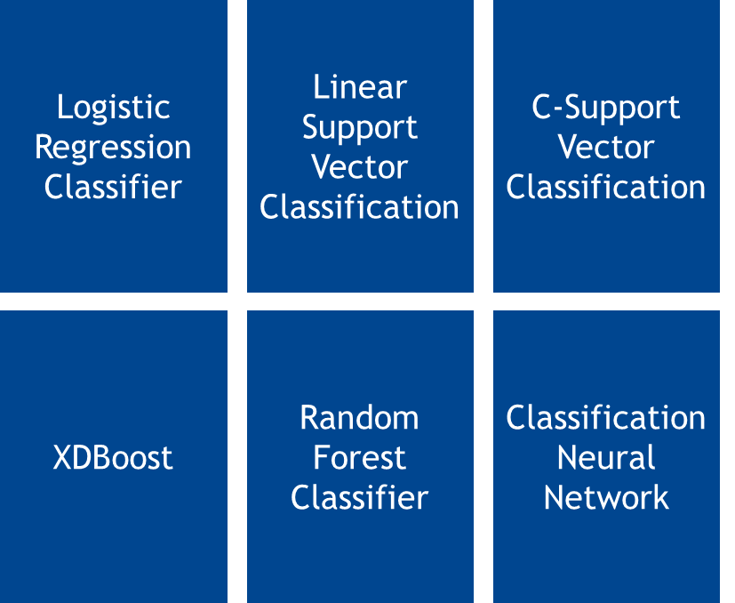

Methodology
The methodology was divided in 7 steps: Collection, Visualization, Cleansing, Engineering, Development, Selection and Results.
Data Source
Data Exploration
Model Evaluation & Selection
Results
Collection
Visualization
Cleansing
Engineering
Development
Selection
Results
Model development and optimization
Model
Selection
Results Analysis & Conclusions
Each model was developed and optimize to define the best hyperparameters to achieve the best results
After achieving the best results of each model, a analysis will be performed to select the best model to answer the questions
Once the analysis of the results is completed, a presentation for the stakeholders will be prepared with conclusions and next steps.
Under Construction

Slide 9
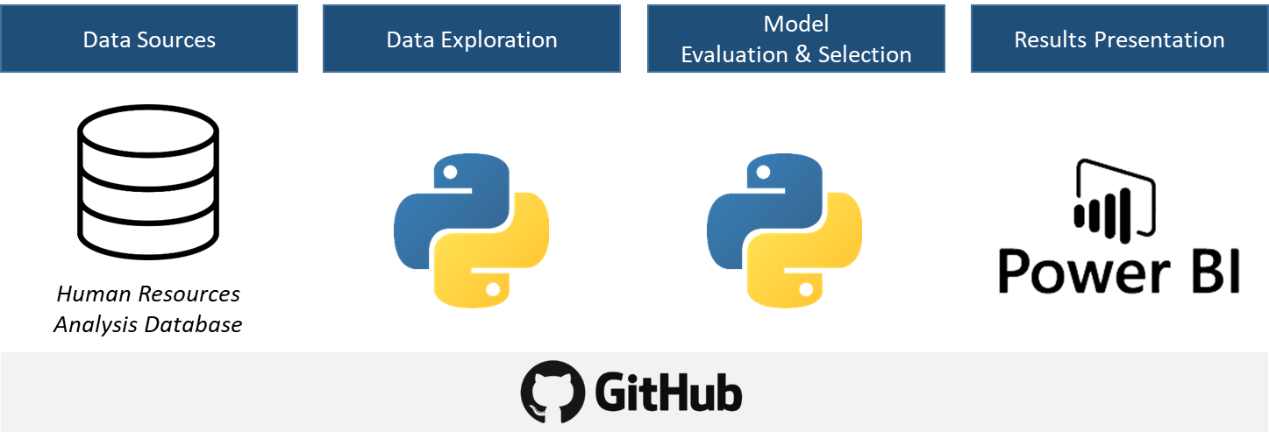




Methodology
We have elected the GithHub collaborative platform to support in the evolution of the project; Python as the programming language and Power Bi for data exploration and results presentation.
Data Sources
Data Exploration
Model Evaluation & Selection
Results Presentation

Slide 10
Planning
Currently finalizing the development and optimization of the models, we will start to analyze the outputs, select the model or models to answer the questions and start preparing the second status report.
16/Oct
23/Oct
30/Oct
06/Nov
13/Nov
20/Nov
27/Nov
04/Dec
11/Dec
Collection
Status Report
Visualization
Cleansing
Engineering
Interim Presentation
Development
Status Report
Selection
Report and Results Presentation
Results
Now

Slide 11
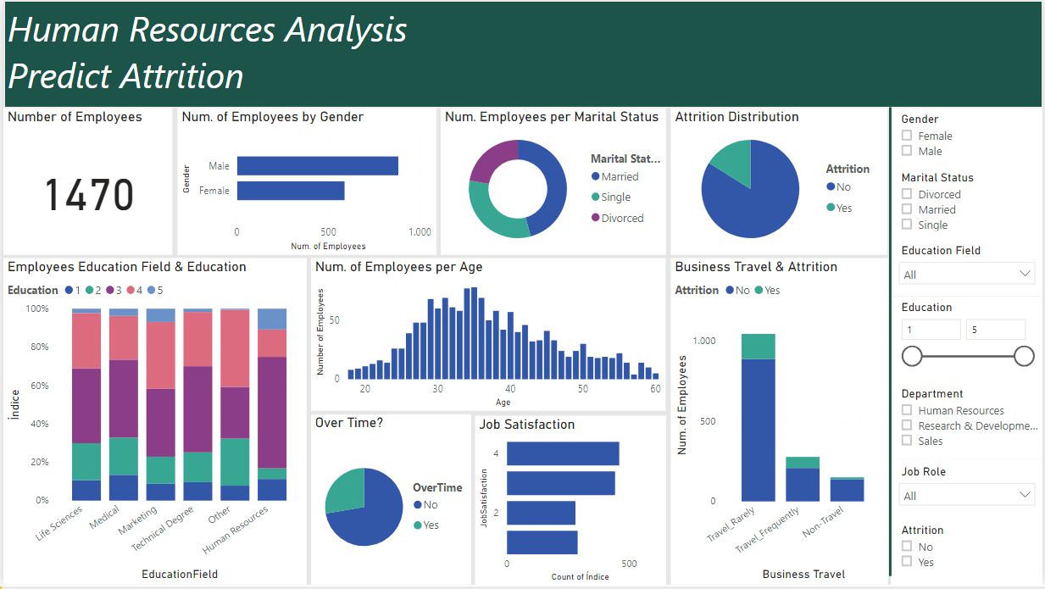
Dataset Exploration
Power BI was the tool used for the initial understanding of the dataset. The initial exploration allowed for a descriptive analysis of the employees:
Inserir Power BI sem filtros
Nº of Employees: 1470
Nº Attrition: 237 (16,12%)
Average age: 37
Average income: 6500
Gender distribution:
Male– 882 (60%)
Female – 588 (40%)
Marital status distribution:
Married- 673 (46%)
Single - 470 (32%)
Divorced - 327 (22%)
Overtime:
Yes – 28%
No - 72%
Job Satisfaction distribution:
4: 459
3: 442
2: 280
1: 289
Avg. years since promotion: 2,2

Slide 12
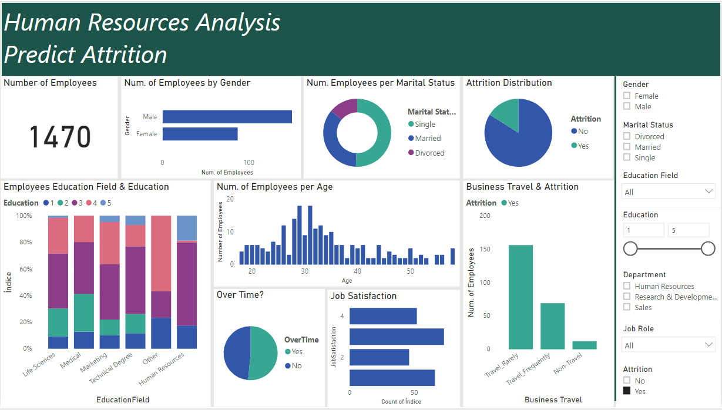
Dataset Exploration
Power BI also allowed to get more insight on characteristics of the employees who left the company:
Inserir Power BI sem filtros
Nº of Employees: 1470
Nº Attrition: 237 (16,12%)
Average age: 34 (37)
Average income: 4800 (6500)
Gender distribution:
Male – 150 [63%] – (882 [60%])
Female– 87 [37%] - (588 [40%])
Marital status distribution:
Married– 84 [35%] - ((673 [46%])
Single – 120 [51%] - (470 [32%])
Divorced - 33 (14%) - (327[22%])
Overtime:
Yes – 51% (50%)
No - 49% (50%)
Job Satisfaction distribution:
4: 52 (459)
3: 73 (442)
2: 46 (280)
1: 66 (289)
Avg. years since promotion:1,95 (2,2)

Slide 13
Preliminary Results
The preliminary results achieved so far are present in the following table. The models will be optimized to improve their performance and then select the best model for each question.
Model | True Positive | False Positive | True Negative | False Negative | Accuracy | PPV (Precision) | TPR (Recall) | Auc Score | F1 Score
Logistic Regression Classifier | 16 | 30 | 93 | 8 | 0,7415 | 0,3478 | 0,6667 | 0,8472 | 0,4571
Linear Support Vector Classification | 11 | 4 | 119 | 13 | 0,8844 | 0,7333 | 0,4583 | 0,8482 | 0,5641
C-Support Vector Classification | 6 | 1 | 122 | 18 | 0,8707 | 0,8571 | 0,2500 | 0,8404 | 0,3871
XDBoost | 7 | 2 | 121 | 17 | 0,8707 | 0,7778 | 0,2917 | 0,8113 | 0,4242
Random Forest Classifier | 11 | 9 | 114 | 13 | 0,8503 | 0,5500 | 0,4583 | 0,7947 | 0,5000
Classification Neural Network | 16 | 21 | 102 | 8 | 0,8027 | 0,4324 | 0,6667 | 0,8242 | 0,5246

Slide 14
Score Selection
In theoretical terms, there are a lot of scores to consider when selecting the model. Normally, the F₁ score is the one that is used to selected the best models but...
 |  | True Condition
 | Total population | Condition positive | Condition negative | Prevalence = Σ Condition positive/Σ Total population | Accuracy (ACC) = Σ True positive + Σ True negative /Σ Total population
Predicted Condition | Predicted condition positive | True positive | False positive, Type I error | Positive predictive value (PPV) Precision = Σ True positive /Σ Predicted condition positive | False discovery rate (FDR) = Σ False positive /Σ Predicted condition positive
 | Predicted condition negative | False negative, Type II error | True negative | False omission rate (FOR) = Σ False negative /Σ Predicted condition negative | Negative predictive value (NPV) = Σ True negative /Σ Predicted condition negative
 |  | True positive rate (TPR), Recall, Sensitivity, probability of detection, Power = Σ True positive /Σ Condition positive | False positive rate (FPR), Fall-out, probability of false alarm = Σ False positive /Σ Condition negative | Positive likelihood ratio (LR+) = TPR/FPR | Diagnostic odds ratio (DOR) = LR+/LR− | F₁ score = 2 · Precision · Recall / Precision + Recall | MCC = (TP ·TN – FP-FN) / √ [(TP+FP) (TP+FN) (TN+FP) (TN+FN)]
 |  | False negative rate (FNR), Miss rate = Σ False negative /Σ Condition positive | Specificity (SPC), Selectivity, True negative rate (TNR) = Σ True negative /Σ Condition negative | Negative likelihood ratio (LR−) = FNR/TNR
MCC - Matthews correlation coefficient

Slide 15
Score Selection
MCC is more informative than any other confusion matrix measures in evaluating binary classification problems because it takes into account the balance ratios of the 4 confusion matrix categories (TP, TN, FP and FN)
 |  | True Condition
 | Total population | Condition positive | Condition negative | Prevalence = Σ Condition positive/Σ Total population | Accuracy (ACC) = Σ True positive + Σ True negative /Σ Total population
Predicted Condition | Predicted condition positive | True positive | False positive, Type I error | Positive predictive value (PPV) Precision = Σ True positive /Σ Predicted condition positive | False discovery rate (FDR) = Σ False positive /Σ Predicted condition positive
 | Predicted condition negative | False negative, Type II error | True negative | False omission rate (FOR) = Σ False negative /Σ Predicted condition negative | Negative predictive value (NPV) = Σ True negative /Σ Predicted condition negative
 |  | True positive rate (TPR), Recall, Sensitivity, probability of detection, Power = Σ True positive /Σ Condition positive | False positive rate (FPR), Fall-out, probability of false alarm = Σ False positive /Σ Condition negative | Positive likelihood ratio (LR+) = TPR/FPR | Diagnostic odds ratio (DOR) = LR+/LR− | F₁ score = 2 · Precision · Recall / Precision + Recall | MCC = (TP ·TN – FP-FN) / √ [(TP+FP) (TP+FN) (TN+FP) (TN+FN)]
 |  | False negative rate (FNR), Miss rate = Σ False negative /Σ Condition positive | Specificity (SPC), Selectivity, True negative rate (TNR) = Σ True negative /Σ Condition negative | Negative likelihood ratio (LR−) = FNR/TNR
MCC - Matthews correlation coefficient

Slide 16
Score Selection
However, to answer “Who is going to leave the company?“ the model with the best TPR or the best PPV must be consider since the one with the best MCC or F1 score may not be the one who predicts attrition better.
 |  | True Condition
 | Total population | Condition positive | Condition negative | Prevalence = Σ Condition positive/Σ Total population | Accuracy (ACC) = Σ True positive + Σ True negative/Σ Total population
Predicted Condition | Predicted condition positive | True positive | False positive, Type I error | Positive predictive value (PPV) Precision = Σ True positive /Σ Predicted condition positive | False discovery rate (FDR) = Σ False positive /Σ Predicted condition positive
 | Predicted condition negative | False negative, Type II error | True negative | False omission rate (FOR) = Σ False negative /Σ Predicted condition negative | Negative predictive value (NPV) = Σ True negative /Σ Predicted condition negative
 |  | True positive rate (TPR), Recall, Sensitivity, probability of detection, Power = Σ True positive /Σ Condition positive | False positive rate (FPR), Fall-out, probability of false alarm = Σ False positive /Σ Condition negative | Positive likelihood ratio (LR+) = TPR/FPR | Diagnostic odds ratio (DOR) = LR+/LR− | F₁ score = 2 · Precision · Recall / Precision + Recall | MCC = (TP ·TN – as FP-FN) / √ [(TP+FP) (TP+FN) (TN+FP) (TN+FN)]
 |  | False negative rate (FNR), Miss rate = Σ False negative /Σ Condition positive | Specificity (SPC), Selectivity, True negative rate (TNR) = Σ True negative/ Σ Condition negative | Negative likelihood ratio (LR−) = FNR/TNR
Who is going to leave the company?
“Prisoner’s Dilemma” adapted to the HR - Attrition Case: What do you prefer?
Identify someone who wasn’t going to leave the company as “Potential attrition”
OR
Don’t identify someone who is going to leave
MCC - Matthews correlation coefficient

Slide 17
Score Selection
The TPR is the score that optimizes the true positives. However it doesn’t take into account the false positives. With the PPV score, false positives are minimized but there are more false negatives.
Model | True Positive | False Positive | True Negative | False Negative | Accuracy | PPV (Precision) | TPR (Recall) | F1 Score | MCC
Logistic Regression Classifier | 16 | 30 | 93 | 8 | 0,7415 | 0,3478 | 0,6667 | 0,4571 | 0,3370
Linear Support Vector Classification | 11 | 4 | 119 | 13 | 0,8844 | 0,7333 | 0,4583 | 0,5641 | 0,5199
C-Support Vector Classification | 6 | 1 | 122 | 18 | 0,8707 | 0,8571 | 0,2500 | 0,3871 | 0,4198
XDBoost | 7 | 2 | 121 | 17 | 0,8707 | 0,7778 | 0,2917 | 0,4242 | 0,4246
Random Forest Classifier | 11 | 9 | 114 | 13 | 0,8503 | 0,5500 | 0,4583 | 0,5000 | 0,4152
Classification Neural Network | 16 | 21 | 102 | 8 | 0,8027 | 0,4324 | 0,6667 | 0,5246 | 0,4224
TPR – True positive rate PPV - Positive predictive value

Slide 18
Score Selection
The TPR is the score that optimizes the true positives. However it doesn’t take into account the false positives. With the PPV score, false positives are minimized but there are more false negatives.
Model | True Positive | False Positive | True Negative | False Negative | Accuracy | PPV (Precision) | TPR (Recall) | F1 Score | MCC
Logistic Regression Classifier | 16 | 30 | 93 | 8 | 0,7415 | 0,3478 | 0,6667 | 0,4571 | 0,3370
Linear Support Vector Classification | 11 | 4 | 119 | 13 | 0,8844 | 0,7333 | 0,4583 | 0,5641 | 0,5199
C-Support Vector Classification | 6 | 1 | 122 | 18 | 0,8707 | 0,8571 | 0,2500 | 0,3871 | 0,4198
XDBoost | 7 | 2 | 121 | 17 | 0,8707 | 0,7778 | 0,2917 | 0,4242 | 0,4246
Random Forest Classifier | 11 | 9 | 114 | 13 | 0,8503 | 0,5500 | 0,4583 | 0,5000 | 0,4152
Classification Neural Network | 16 | 21 | 102 | 8 | 0,8027 | 0,4324 | 0,6667 | 0,5246 | 0,4224
LET THE STAKEHOLDER DECIDE
TPR – True positive rate PPV - Positive predictive value

Slide 19
Score Selection
For the question “What can we do to avoid attrition?” – that needs a prescriptive analyses - the most important features for the models must be found and mitigated. No score can help with the answer.
 |  | True Condition
 | Total population | Condition positive | Condition negative | Prevalence = Σ Condition positive/Σ Total population | Accuracy (ACC) = Σ True positive + Σ True negative/Σ Total population
Predicted Condition | Predicted condition positive | True positive | False positive, Type I error | Positive predictive value (PPV) Precision = Σ True positive/Σ Predicted condition positive | False discovery rate (FDR) = Σ False positive /Σ Predicted condition positive
 | Predicted condition negative | False negative, Type II error | True negative | False omission rate (FOR) = Σ False negative /Σ Predicted condition negative | Negative predictive value (NPV) = Σ True negative /Σ Predicted condition negative
 |  | True positive rate (TPR), Recall, Sensitivity, probability of detection, Power = Σ True positive /Σ Condition positive | False positive rate (FPR), Fall-out, probability of false alarm = Σ False positive /Σ Condition negative | Positive likelihood ratio (LR+) = TPR/FPR | Diagnostic odds ratio (DOR) = LR+/LR− | F₁ score = 2 · Precision · Recall / Precision + Recall | MCC = (TP ·TN – as FP-FN) / √ [(TP+FP) (TP+FN) (TN+FP) (TN+FN)]
 |  | False negative rate (FNR), Miss rate = Σ False negative /Σ Condition positive | Specificity (SPC), Selectivity, True negative rate (TNR) = Σ True negative/ Σ Condition negative | Negative likelihood ratio (LR−) = FNR/TNR
What can we do to avoid attrition?
The features with more influence in the best attrition model will be listed and then..
MCC - Matthews correlation coefficient

Slide 20
Score Selection
For the question “What can we do to avoid attrition?” – that needs a prescriptive analyses - the most important features for the models must be found and mitigated. No score can help with the answer.
 |  | True Condition
 | Total population | Condition positive | Condition negative | Prevalence = Σ Condition positive/Σ Total population | Accuracy (ACC) = Σ True positive + Σ True negative/Σ Total population
Predicted Condition | Predicted condition positive | True positive | False positive, Type I error | Positive predictive value (PPV) Precision = Σ True positive/Σ Predicted condition positive | False discovery rate (FDR) = Σ False positive /Σ Predicted condition positive
 | Predicted condition negative | False negative, Type II error | True negative | False omission rate (FOR) = Σ False negative /Σ Predicted condition negative | Negative predictive value (NPV) = Σ True negative /Σ Predicted condition negative
 |  | True positive rate (TPR), Recall, Sensitivity, probability of detection, Power = Σ True positive /Σ Condition positive | False positive rate (FPR), Fall-out, probability of false alarm = Σ False positive /Σ Condition negative | Positive likelihood ratio (LR+) = TPR/FPR | Diagnostic odds ratio (DOR) = LR+/LR− | F₁ score = 2 · Precision · Recall / Precision + Recall | MCC = (TP ·TN – as FP-FN) / √ [(TP+FP) (TP+FN) (TN+FP) (TN+FN)]
 |  | False negative rate (FNR), Miss rate = Σ False negative /Σ Condition positive | Specificity (SPC), Selectivity, True negative rate (TNR) = Σ True negative/ Σ Condition negative | Negative likelihood ratio (LR−) = FNR/TNR
What can we do to avoid attrition?
The features with more influence in the best attrition model will be listed and then..
LET THE STAKEHOLDER DECIDE
MCC - Matthews correlation coefficient

Slide 21

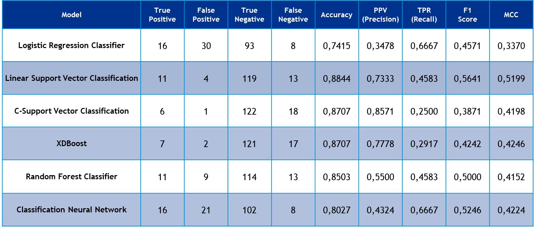



Next Steps
The next steps include an optimization and evaluation of the models and theirs scores to answer “Who is going to leave the company?“ and a prescriptive analysis to help the stakeholder implement measures to prevent it
Which Model?
Who is going to leave the company?
Why is he or she going to leave the company?
Optimize the models
What can we do to prevent it?

Slide 22
Thank You!

